Slide 1
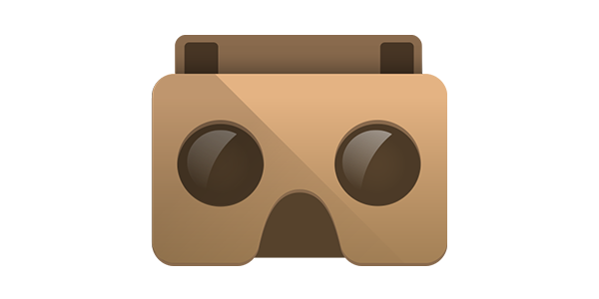
GOOGLE CARDBOARD VIRTUAL REALITY
Presented
By
SIDDHARTH SHUKLA
IT B 108

Slide 2
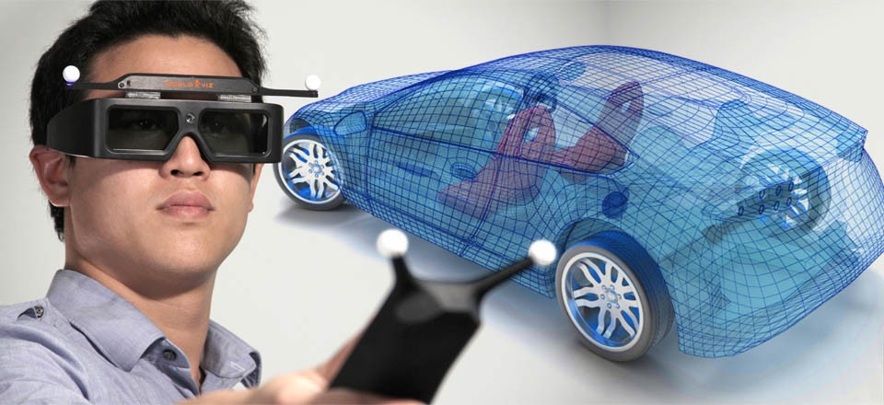
INTRODUCTION OF VIRTUAL REALITY
Virtual Reality (VR) is a way for humans to visualize, manipulate and interact with computers and extremely complex data.

Slide 3
HISTORY OF VIRTUAL REALITY
In 1965, Ivan Sutherland expressed his ideas of creating virtual or imaginary worlds.
In 1969, he developed the first system to surround people in three dimensional displays of information
The concept of virtual reality was mainly used by the United States. They used it as flight simulators to train pilots
Since then, virtual reality has developed in many ways to become an emerging technology of our time.

Slide 4
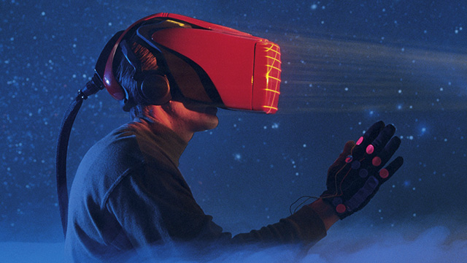
Technology of virtual reality
Virtual Reality Using Hardware
There is a number of hardware developed for the usage by Virtual Reality. Among them some are explained below.
Head Mounted Display :
The Head mounted display consists of two miniature display screens that produce the stereo scopic images and an optical position tracking system that tracks the orientation of the humans head in the Virtual world.

Slide 5
Continued…
Virtual Reality Using Software
The most commonly used tools for developing 3d worlds are VRML v1.0, VRML97, VRML v2.0, 3d Studio max, and other such software. There are many concepts of developing the virtual worlds using the software.
Programming:
The other tool available for developing the virtual worlds is by programming. There are many programming languages by which we can develop the virtual worlds. The best one we prefer is by using VRML v2.0. Prior to this language, people used to develop the virtual worlds using the traditional programming language, JAVA.

Slide 6
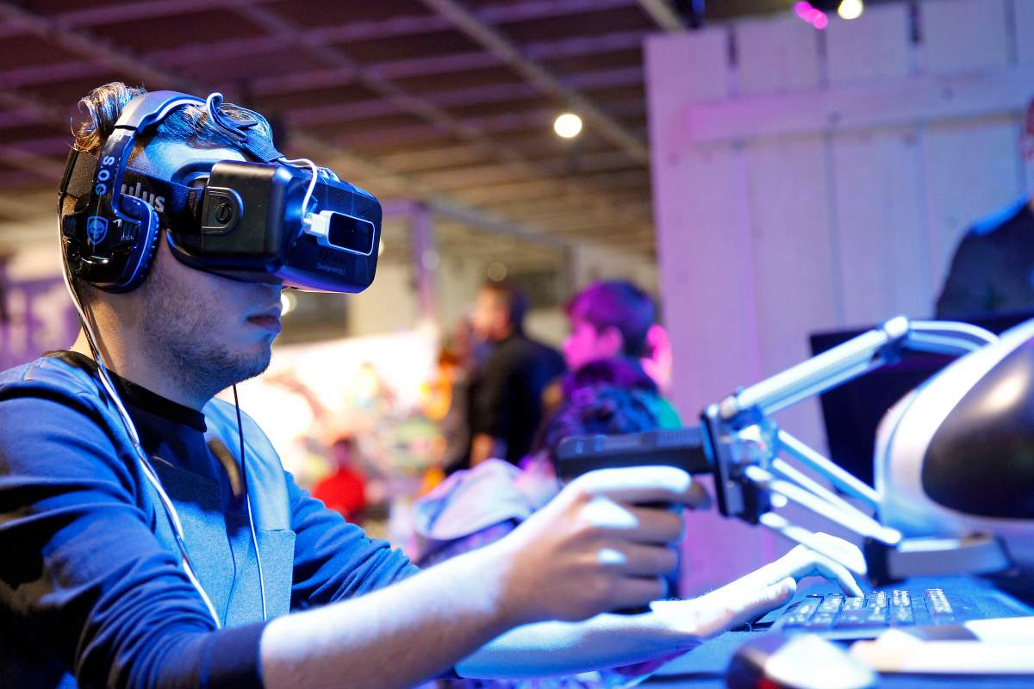
Current problems with Vr Headsets
Cyber sickness: Cyber sickness is a term to describe motion sickness experienced by users of head-steered Virtual Reality systems.
Low-fidelity: It is a type of sound recording which contains technical flaws that make the recording sound different compared with the live sound being recorded.
Very expensive

Slide 7
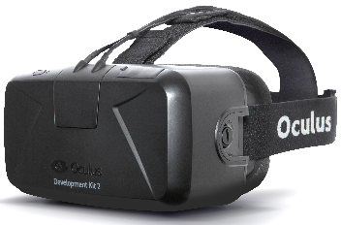
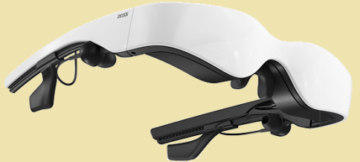
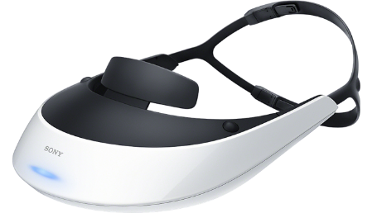
Virtual Reality Headsets
Oculus Rift
Carl Zeiss Cinemizer
Sony HMZ-T2
640x800 Resolution
870x500 Resolution
1280x720 Resolution
90° Horizontal FOV
30° Horizontal FOV
45° Horizontal FOV
13.4 Ounces
4.2 Ounces
11.6 Ounces
7˝ Diagonal Display
0.39˝ Diagonal Display
0.7˝ Diagonal Display
Liquid Crystal Display
Organic Light-Emitting Diode
Organic Light-Emitting Diode
Rs. 21,941.00
Rs. 18,599.00
Rs. 56.699.00

Slide 8
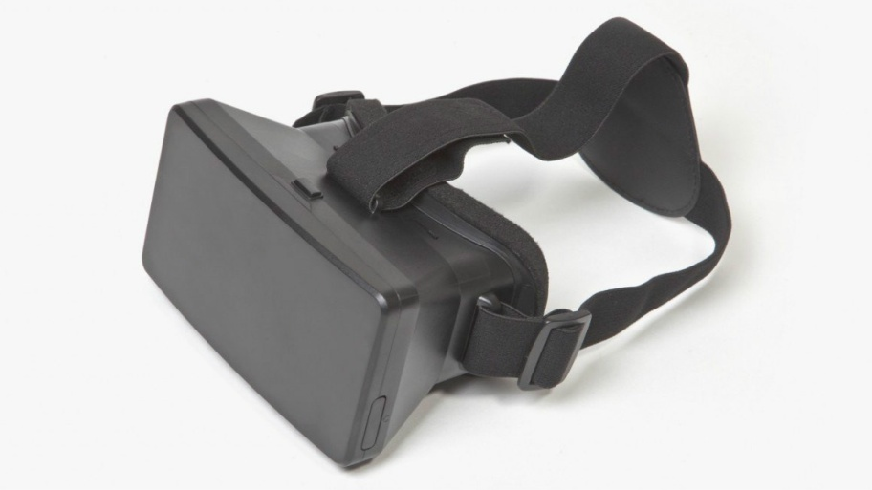
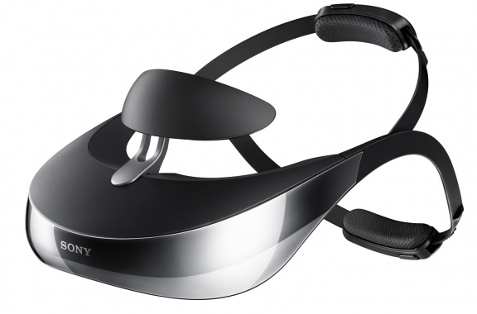
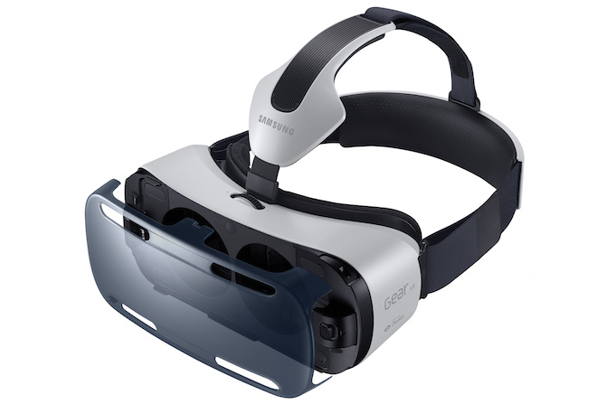
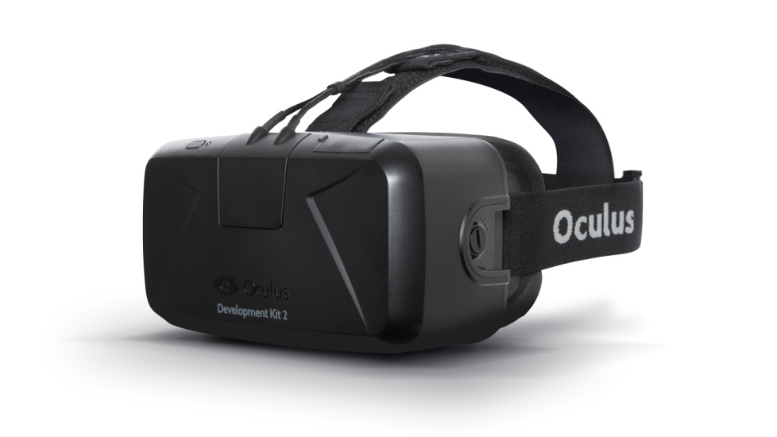
Virtual Reality Head Mounted Displays
DOMO nHance VR Headset Sony HMZ T3 3D HMD
Rs. 18,599.00 Rs. 65,699.00
Samsung Gear VR Headset Oculus Rift VR HMD
Rs. 13,479.00 Rs. 21,941.00

Slide 9
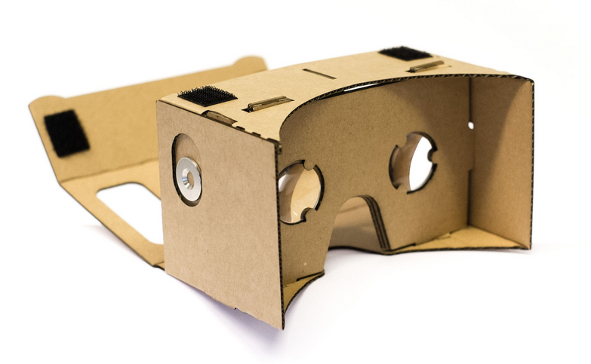
Virtual Reality has made exciting progress over the past several years. Developing for VR still requires expensive, specializes hardware.
Thinking about how to make VR accessible to more people, A group of VR Enthusiasts at Google experimented with using a smart-phone to drive VR experiences.
Google Cardboard Virtual Reality Headset

Slide 10
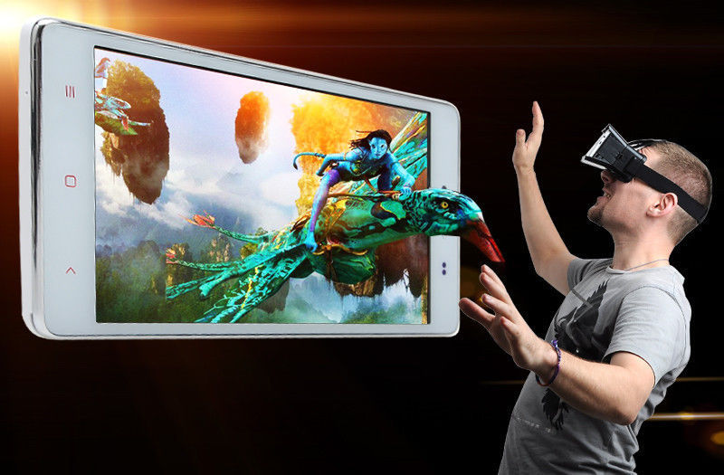
Introduction google cardboard vr
This headset is designed by Google, But there is no official manufacture for this device.
In this new Google product, the users are taken to the new world of virtual reality.
It takes the real world and alters certain parameters to completely change the viewing experience

Slide 11
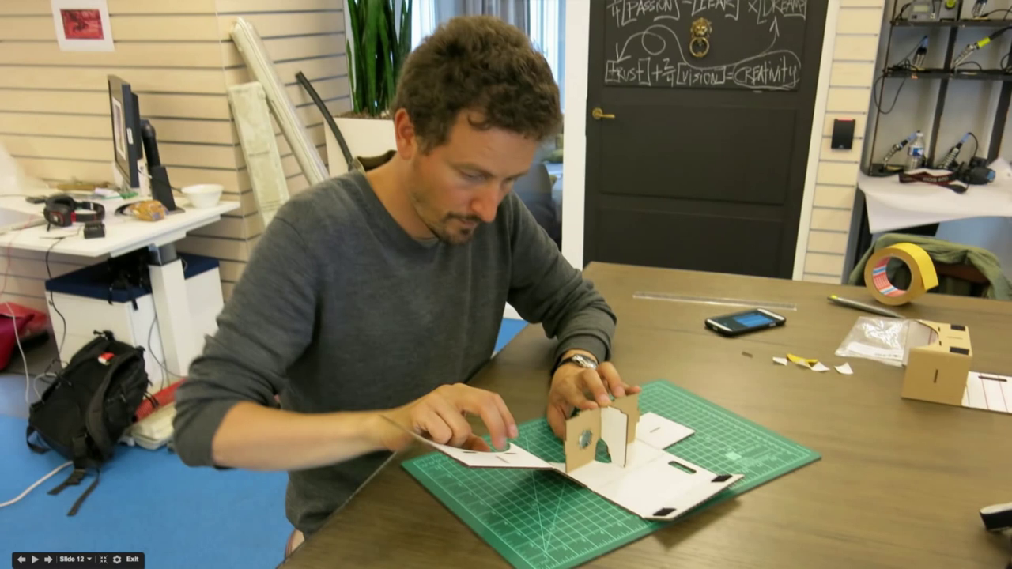
The Google Cardboard was part of a Google 20% project where employees are allowed to work on side projects in addition to their normal everyday duties
This is a simple and inexpensive device. You can download apps meant for this device and enhance your experience of using this device
You can also use it to build your own things with the help of this device.

Slide 12
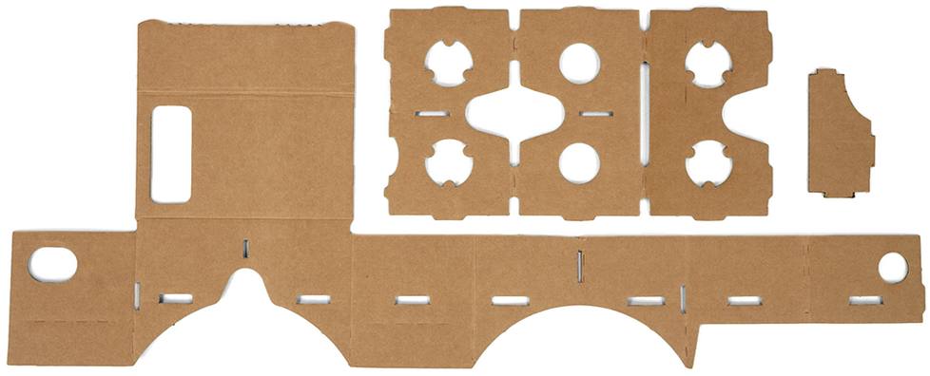
Tools needed to build headset
1) Cardboard:
E-Flute corrugated cardboard sheet
Minimum size: 8.75in (22cm) by 22in (56cm), and 0.06in (1.5mm) thickness.

Slide 13
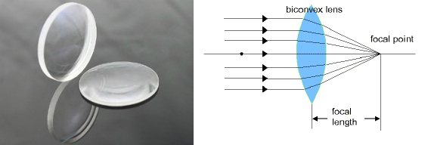
2) Lenses:
Two Asymmetric-BiConvex optical lenses. Lenses that have a 45mm focal distance might work. Biconvex lenses work best because they prevent distortion around the edges.

Slide 14
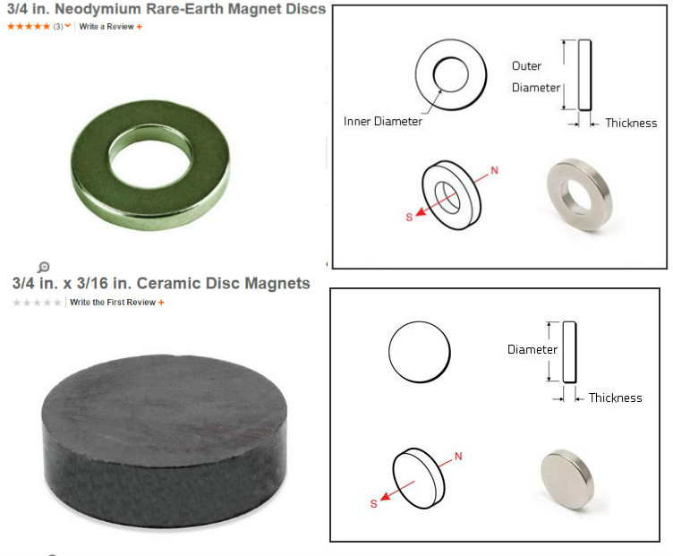
3) Magnet:
One neodymium ring magnet and one ceramic disk magnet

Slide 15
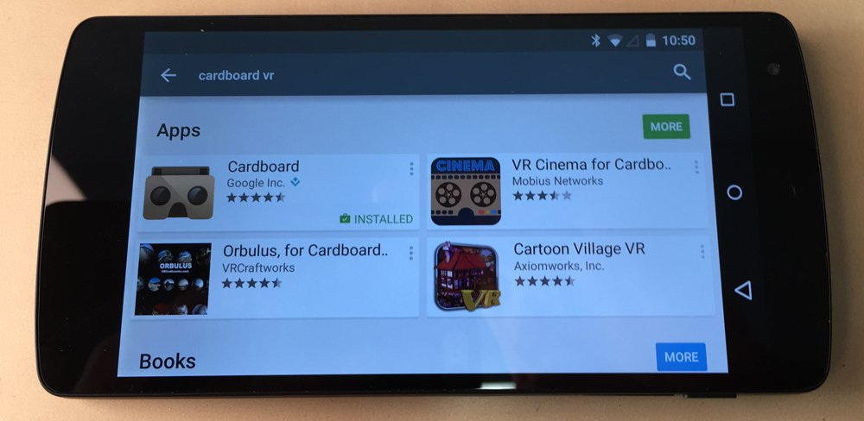
How does it works?
First you need to download the Cardboard app from Google Play. It's a large app - 74.63MB

Slide 16
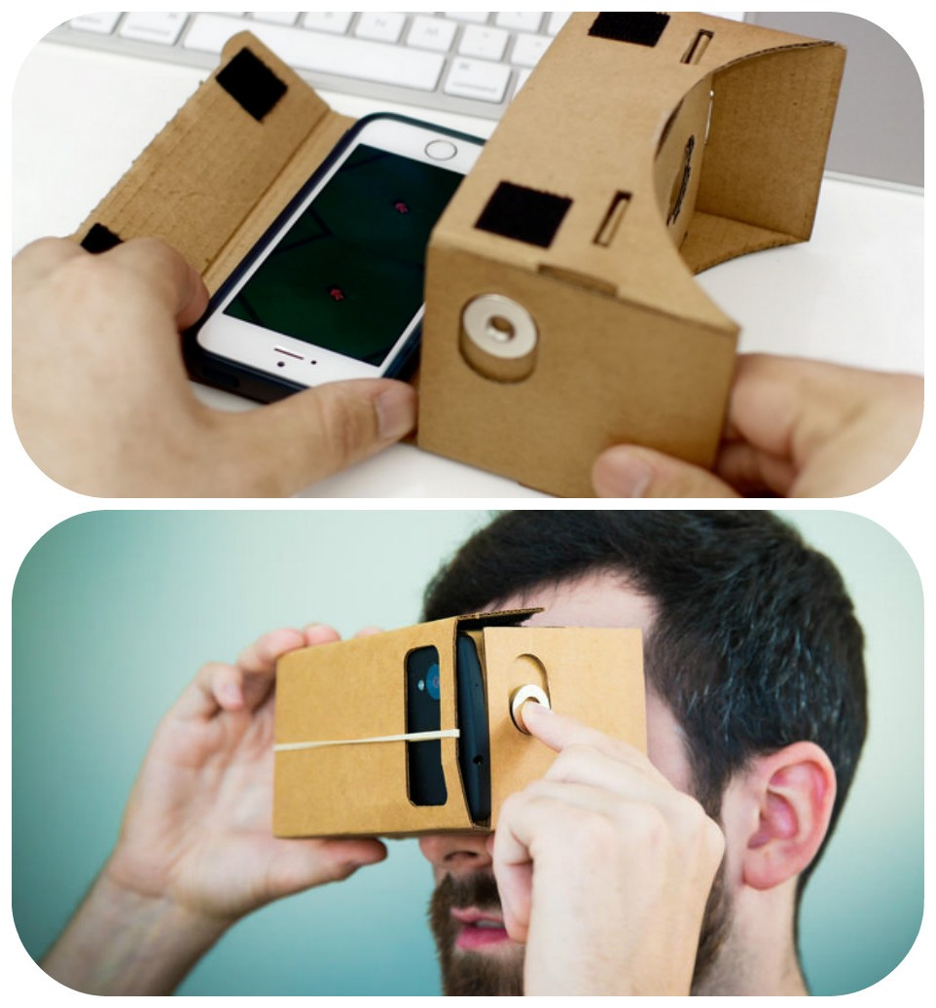
Google Cardboard works by placing your phone at the optimal distance away from the lenses.

Slide 17
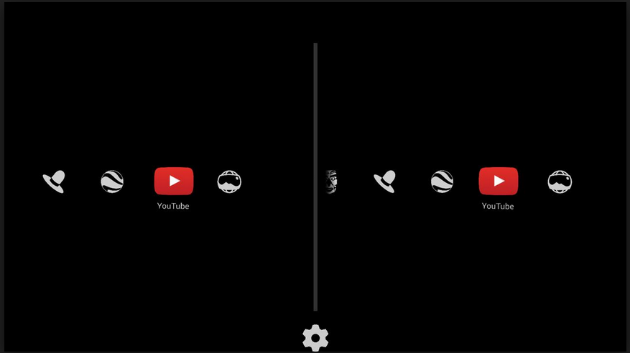
Then, by using compatible apps, the lenses create a 3D effect when held up to your eyes.
You can even move your head around, and the images will respond as if you're in the same place as what's displayed on your screen.
With the Google Cardboard app launched and your phone inside the headset, you'll feel it vibrate. You can then look left and right to scroll through the menu.

Slide 18
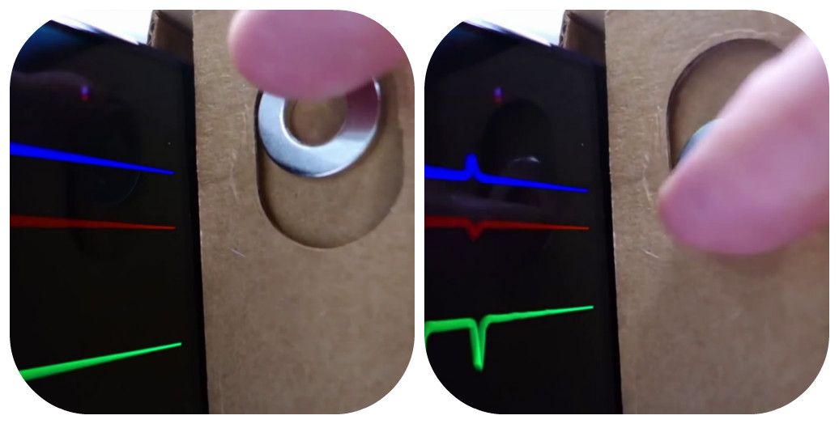
The little magnet on the side is actually a quite ingenious design aspect of Google Cardboard. It's a button!
Since you can't touch your phone's screen while it's inside the Cardboard, Google has provided this magnet that, when moved, acts as if you've pressed your screen.
It uses your phone's magnetometer, which is usually used for compass functions, to sense this and control it while it's in the cardboard

Slide 19
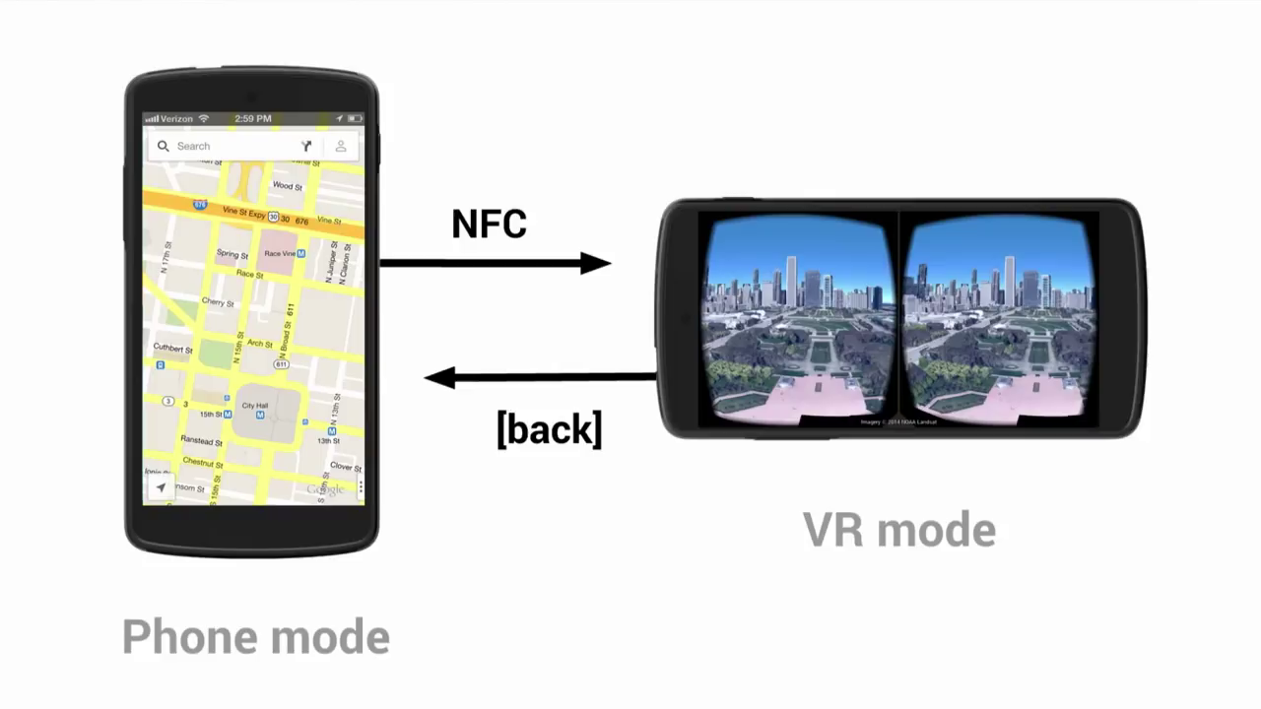
Difference Between Phone Mode and VR mode

Slide 20
applications
The cardboard app comes with 7 experiences:
Earth: Fly where your fancy takes you on Google Earth.
Tour Guide: Visit Versailles with a local guide.
YouTube: Watch popular YouTube videos on a massive screen.
Exhibit: Examine cultural artifacts from every angle.
Photo Sphere: Look around the photo spheres you’ve captured.
Street Vue: Drive through Paris on a summer day.
Windy Day: Follow the story (and the hat) in this interactive animated short from Spotlight Stories.

Slide 21
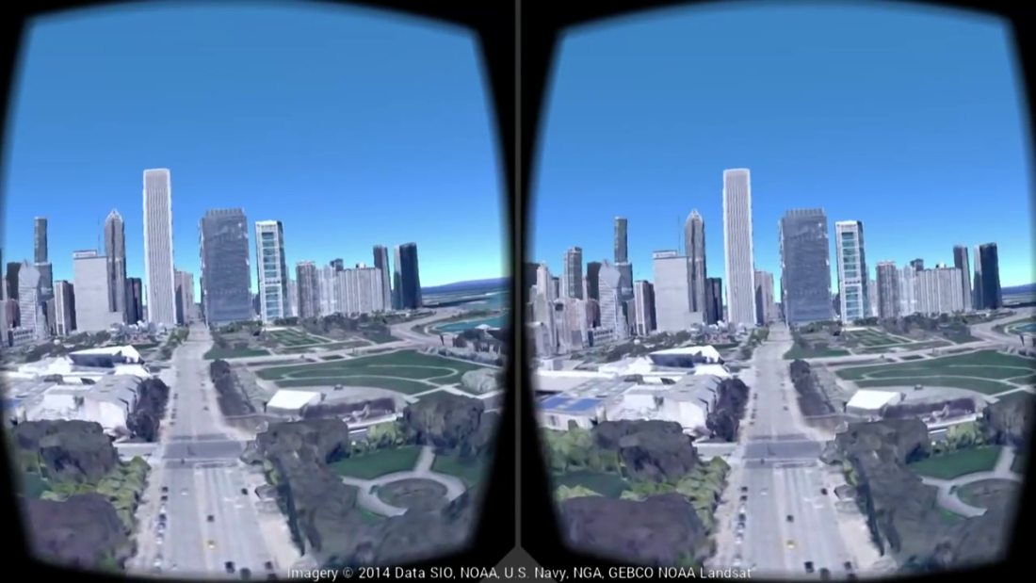
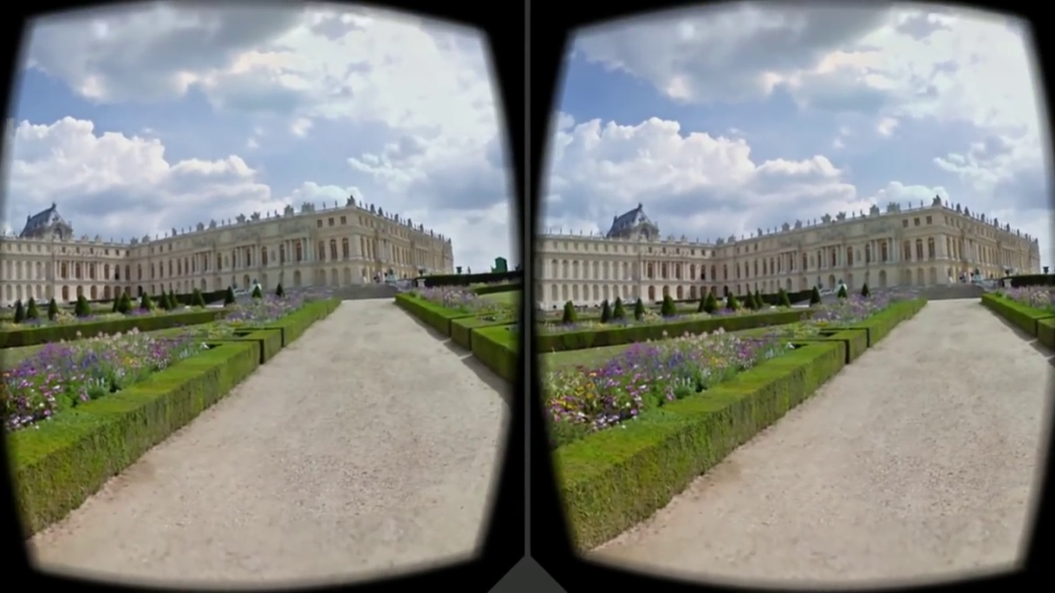
Examples of applications
Earth
Tour guide

Slide 22
features
The Android SDK enables applications with features including:
Lens distortion correction.
Head tracking.
3D calibration.
Side-by-side rendering.
Stereo geometry configuration.
User input event handling.

Slide 23
conclusion
As movement of people is becoming more and The ability of Virtual Reality to produce realistic worlds of data, objects and environments, with which the users can interact and manipulate in a realistic and an intuitive manner, opens up a vast wealth of possibilities for work-related applications.
The concept of Virtual Reality provides an innovative mix of entertainment, education and State-of-Art. Virtual reality technology will transport guests to different worlds.

Slide 24
references
http://www.collegelib.com/t-google-cardboard-virtual-reality-seminar-abstract-report.html
https://www.google.com/get/cardboard
http://en.wikipedia.org/wiki/Google_Cardboard
https://www.unofficialcardboard.com/faq/

Slide 25
Thank you

